Slide 1

PINNACLE
What is Yearbook?

Slide 2
WHAT DO WE DO?
The Pinnacle staff strives to create a visually appealing and storytelling yearbook that accurately depicts the year. We, as students, produce a yearbook that can be enjoyed by the entire Carmel High School community.

Slide 3
HOW DO WE DO IT?
As a staff, we work within smaller groups to create the book one spread at a time. Think of it like puzzle pieces coming together to complete a puzzle :)
We conduct interviews to gather content, then we use that content to create spreads that not only inform through words, but tell stories through design visuals.

Slide 4
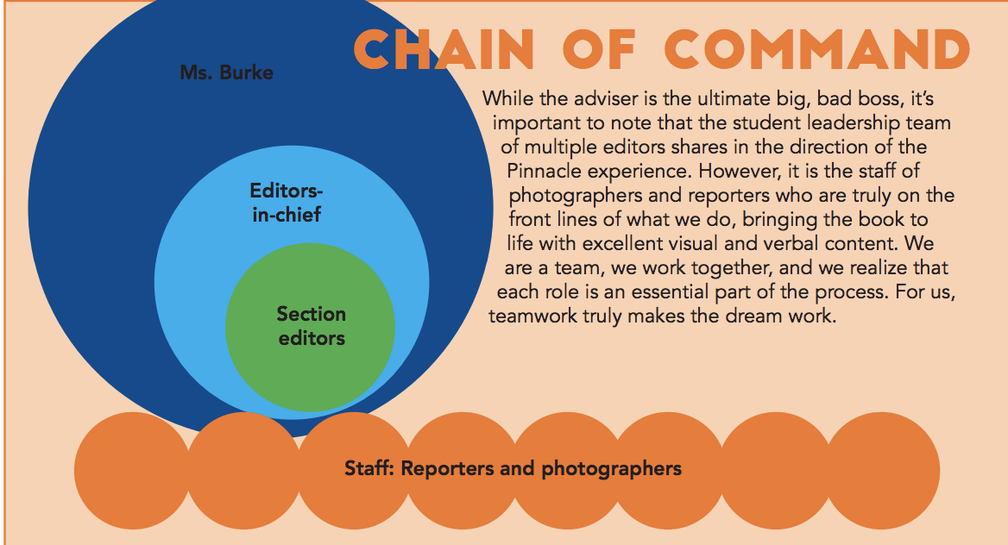
STUDENT LEADERSHIP
For the most part, Pinnacle is completely student-run. We have many editing positions and opportunities for student leadership.

Slide 5
WHY PINNACLE IS GREAT
Collaboration/Communication with fellow yerds
Learn how to write with journalistic integrity
Learn more about technology/digital equipment
Chance to discover parts of CHS you might’ve never encountered
Student-run and many opportunities for leadership
Great way to make a big school seem smaller
Become a part of a supportive staff that serves a purpose bigger than the actual class

Slide 6
QUESTIONS?

